Slide 1
CHANDIGARH
INDIA

Slide 2
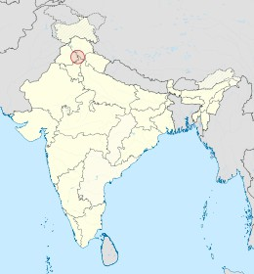
FIRST PLANNED CITY OF INDIA
Chandigarh was conceived as a new city to serve as the capital of Punjab and Haryana after the partition of Punjab in 1947.
The Indian government decided to create a new capital that would symbolize modernity and progress.
Le Corbusier was chosen as the architect to design the city, which was meant to reflect the principles of modernism and meet the needs of a rapidly changing society.

Slide 3
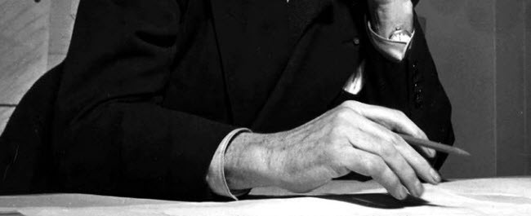
LE CORBUSIER
Le Corbusier, pseudonym of Charles-Édouard Jeanneret, was a visionary architect and urban planner, a pioneer of modernism. He had a revolutionary urban personality, based on the rationalization of space and functionality. He was also a theoretician, an artist and an intellectual, always pushing the boundaries of architectural tradition.

Slide 4
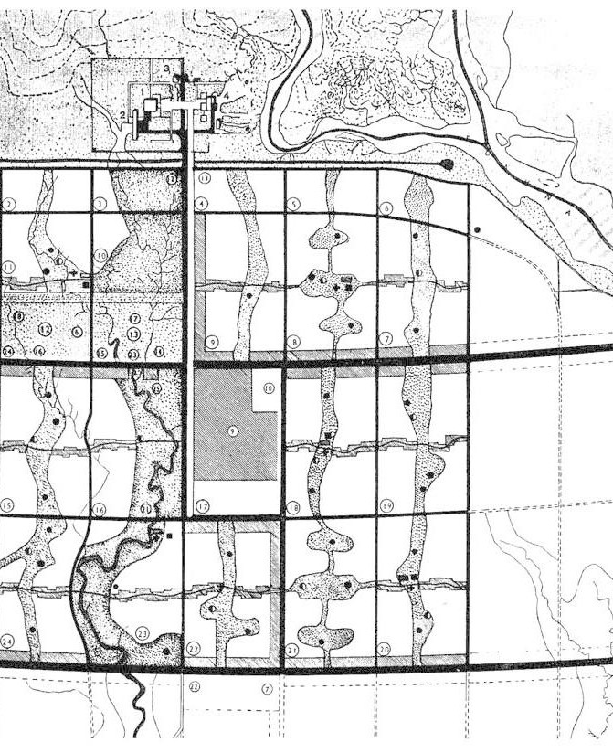
WHAT IS THE UTOPIA THAT ARCHITECTURE SHOULD STRIVE FOR?
GRID SYSTEM OF SECTORS
SELF-SUFFICIENT NEIGHBORHOOD
Separation of urban functions Green areas
MONUMENTALE ARCHITECTURE HUMAN - SCALE

Slide 5
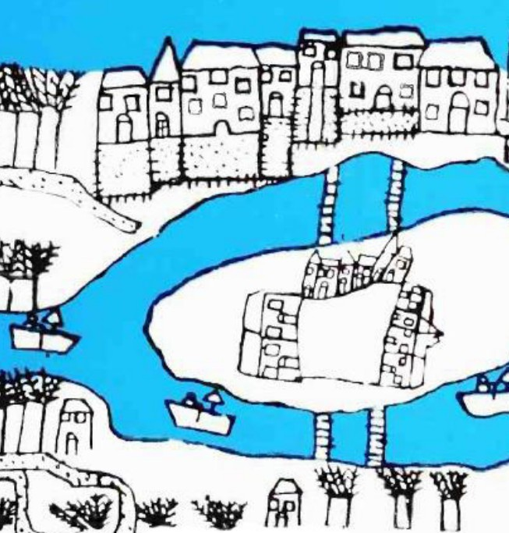
“A CITY IN THE CITY”
self-contained community
The self-sufficient neighborhood concept in Chandigarh represents a model of rational urbanization and functionality, where each sector is designed to meet the daily needs of its residents without requiring long- distance travel.

Slide 6
SECTORS
How much?
Dimension
The human-scale
47
800x800
1,500 inhabitants

Slide 7
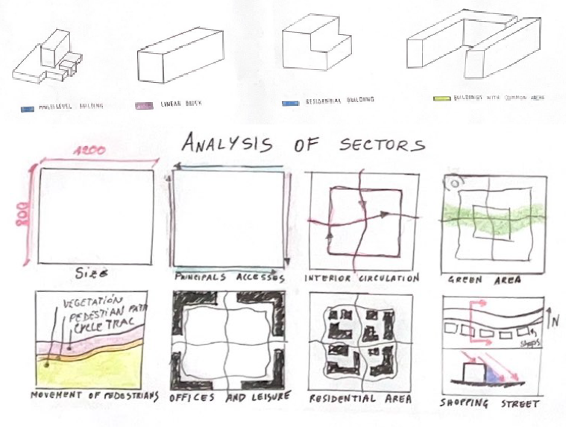
SERVICES WITHIN SECTORS
Local commerce
Housing Education
Social and health services
Green spaces and recreation areas
.

Slide 8
ADVANTAGES
Reduced traffic and congestion
Accessibility to services Support for community life Resilience in Emergencies

Slide 9
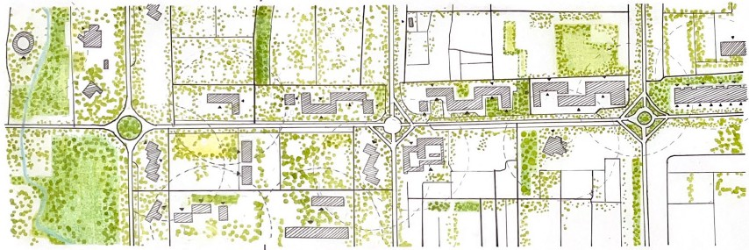
Each sector is surrounded by large green spaces, which not only enhance the aesthetic appeal of the city but also contribute to the quality of life. Parks and public spaces are an integral part of daily life, offering places for meetings, recreation, and relaxation.
INTEGRATION WITH NATURE
INTEGRATION WITH NATURE

